Slide 1

Shri Ramswroop Memorial University
Data Analytics and reporting
(UCS3804)
SUBMITTED BY:
NAME:ANANYA SINHA
ROLL NO.:202410101150240
GROUP:38
COURSE:BTECHCS(DS+AI)
SUBMITTED TO:
MS.DEEPIKA TIWARI

Slide 2
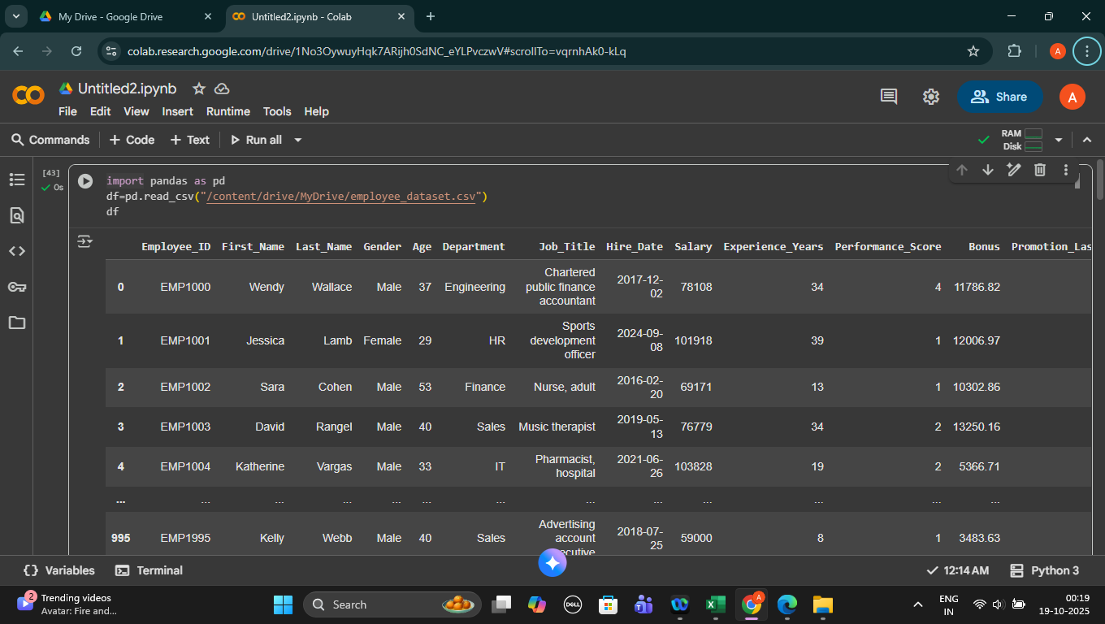
EMPLOYEE DATA (Data Analytics)
A CSV (Comma-Separated Values) file is a plain text file that stores tabular data, such as a spreadsheet or database table. In a CSV file, each line is a new row, and the values within that row are separated by commas. Because it is a simple, plain text format, CSV is one of the most widely used formats for exchanging data between different applications.For example:

Slide 3
What is pandas in python?
Pandas is a popular, open-source Python library used for data manipulation and analysis. It provides data structures and a range of functions that make it easy to clean, process, and analyze structured data like spreadsheets or database tables.
For example:
# Read a CSV file into a DataFrame
# df = pd.read_csv('your_file.csv’)
# print(df)

Slide 4
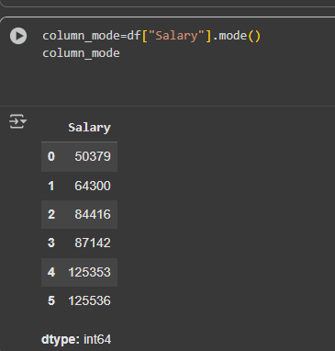

What is mean and mode in python pandas library?
In Python's Pandas library, mean() and mode() are functions used to calculate measures of central tendency for data in Series or Data Frames.
The mean, or arithmetic mean, represents the average value of a dataset. It is calculated by summing all the values in a dataset and then dividing by the number of values.
In Pandas: You can calculate the mean of a Series or Data Frame column using the .mean() method.

Slide 5
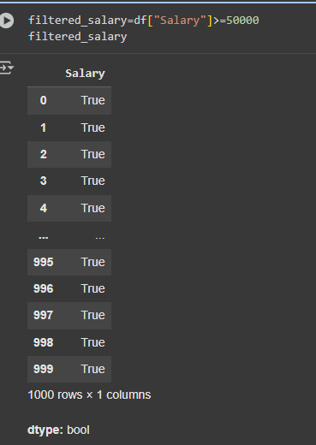
What is Filtering of data in pandas?
Filtering data in Pandas Data Frames involves selecting rows or columns based on specific conditions or labels.
for example:

Slide 6
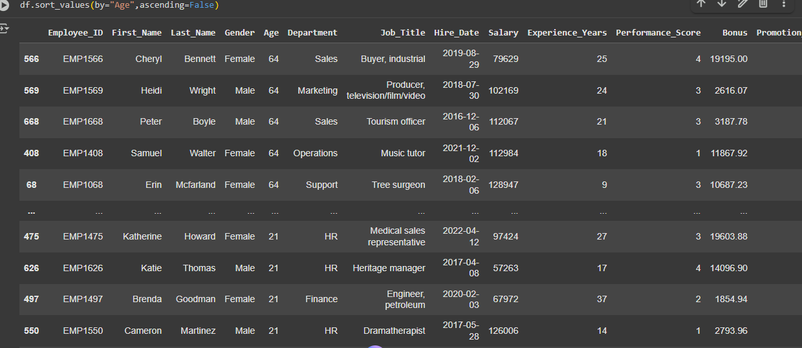
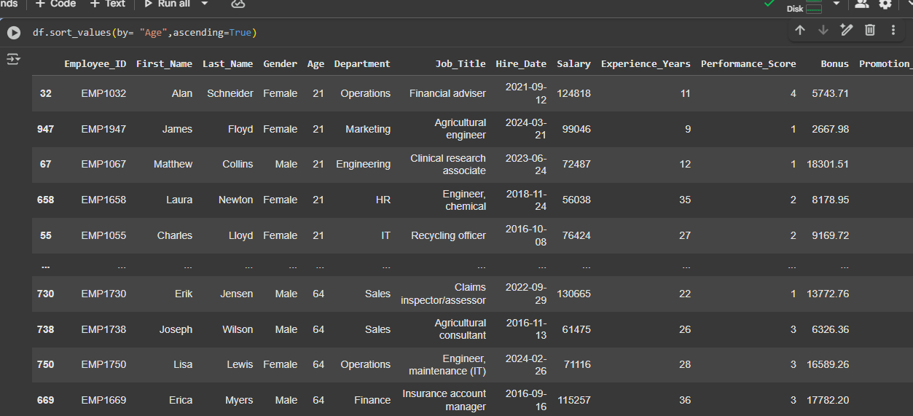
1)Sort the data in ascending/descending order.

Slide 7
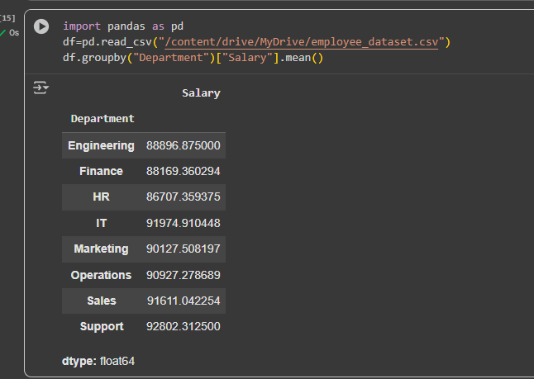
Grouping in pandas?
In Pandas, "grouping" refers to the process of dividing a DataFrame into smaller groups based on the values in one or more specified columns. This operation is performed using the .groupby() method and is a fundamental concept in data analysis.
For example:

Slide 8
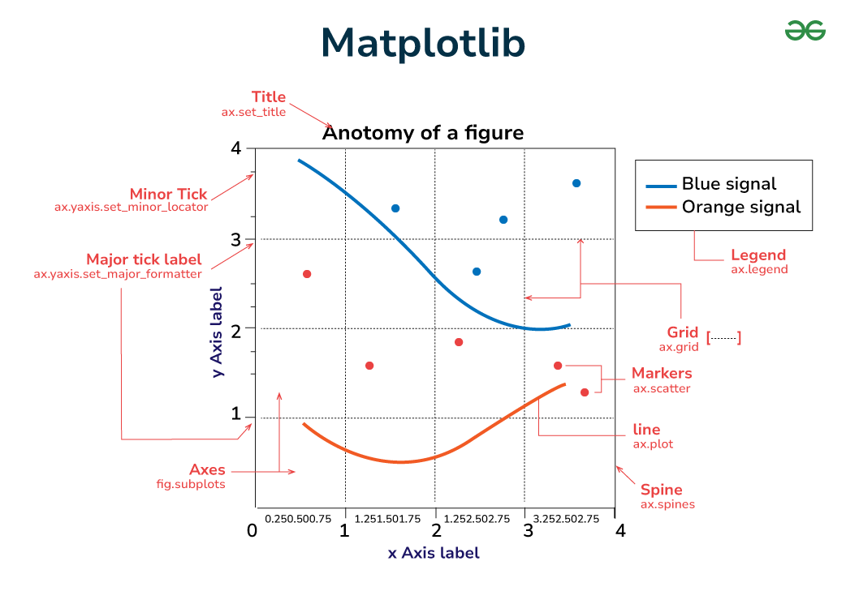
What is Matplotlib in python?
Matplotlib is a comprehensive, open-source plotting library for the Python programming language. It is widely used for creating static, animated, and interactive visualizations in Python, including line plots, scatter plots, bar charts, histograms, and even 3D plots.
For example:

Slide 9
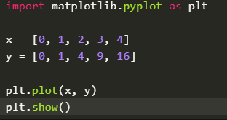
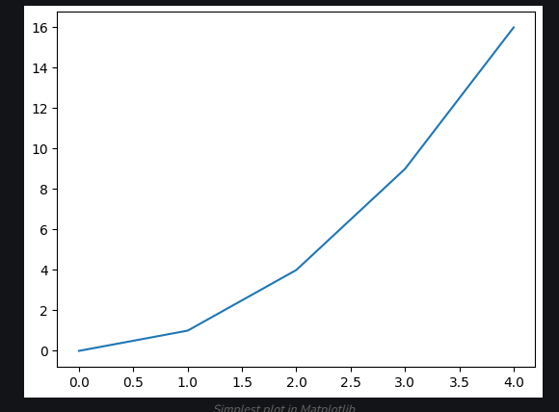
Example of a Plot in Matplotlib:

Slide 10
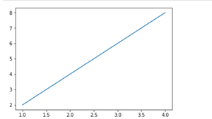
What is line plot in Matplotlib?
Line plots in Python are primarily created using the matplotlib.pyplot library, often imported as plt.

Slide 11
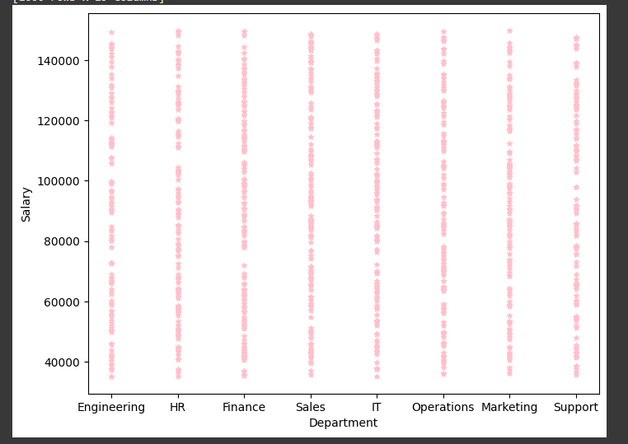
What is scatter plot in matplotlib?
A scatter plot in Python is a type of data visualization that displays individual data points on a two-dimensional graph. It uses Cartesian coordinates to show the relationship between two variables, with one variable plotted on the horizontal (x-axis) and the other on the vertical (y-axis). Each data point is typically represented as a dot or a marker.

Slide 12
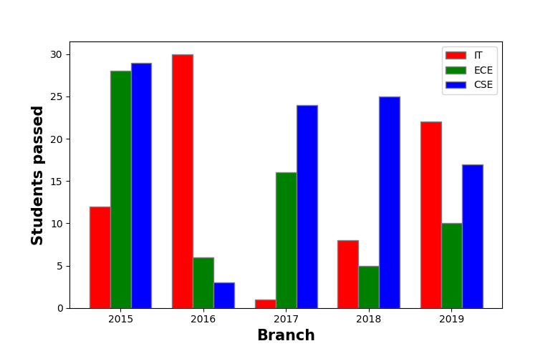
What is bar plot in matplotlib?
Creating a bar plot in Python is commonly done using the matplotlib library, particularly its pyplot module. The bar() function within pyplot is used for this purpose.

Slide 13
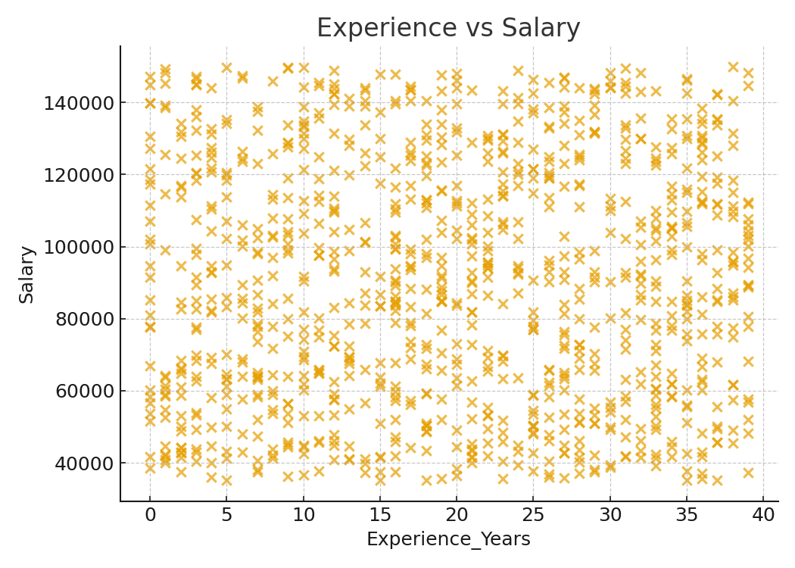
Experience vs Salary (Scatter)
Corr: 0.03

Slide 14
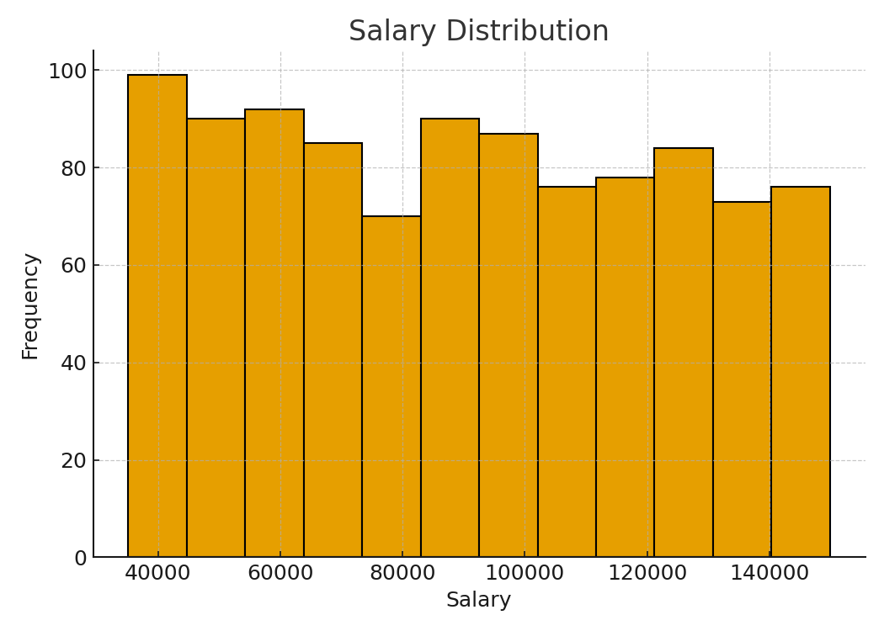
Salary Distribution

Slide 15
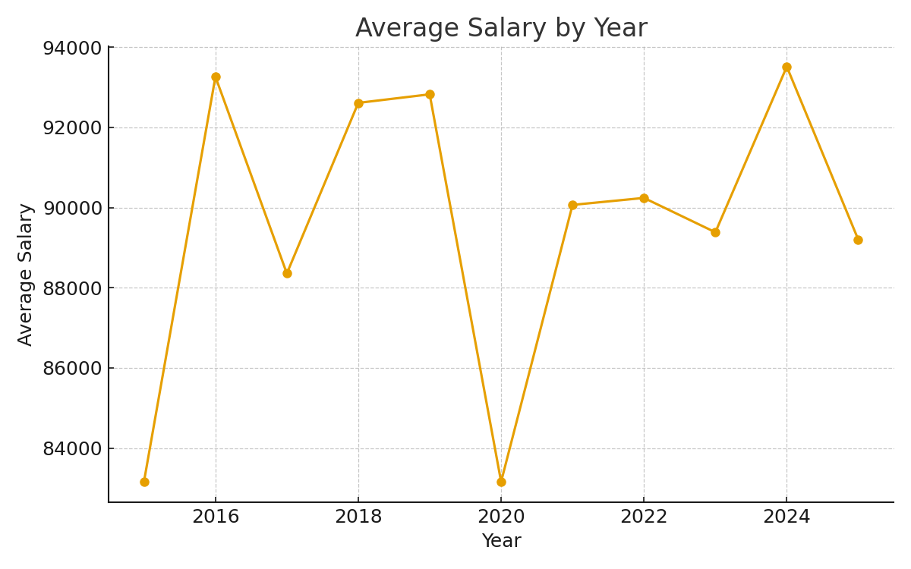
Average Salary by Year

Slide 16
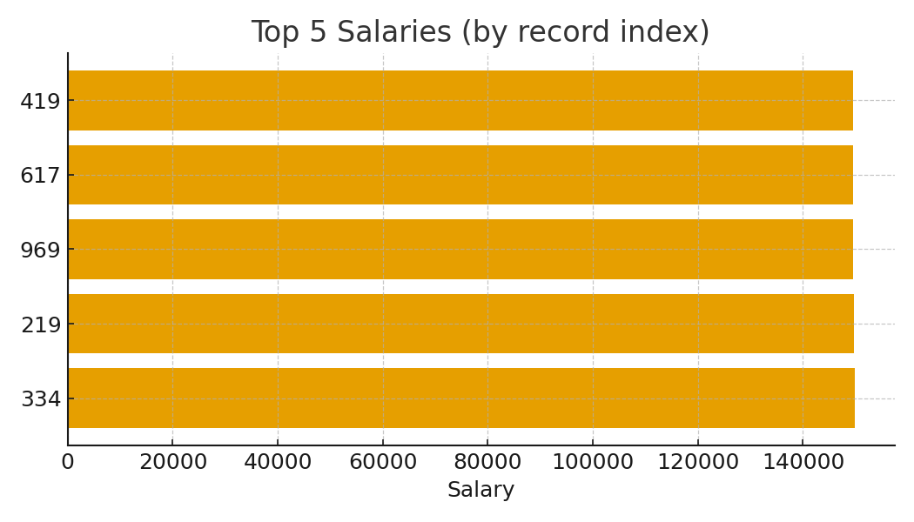
Top 5 Salaries

